Slide 1
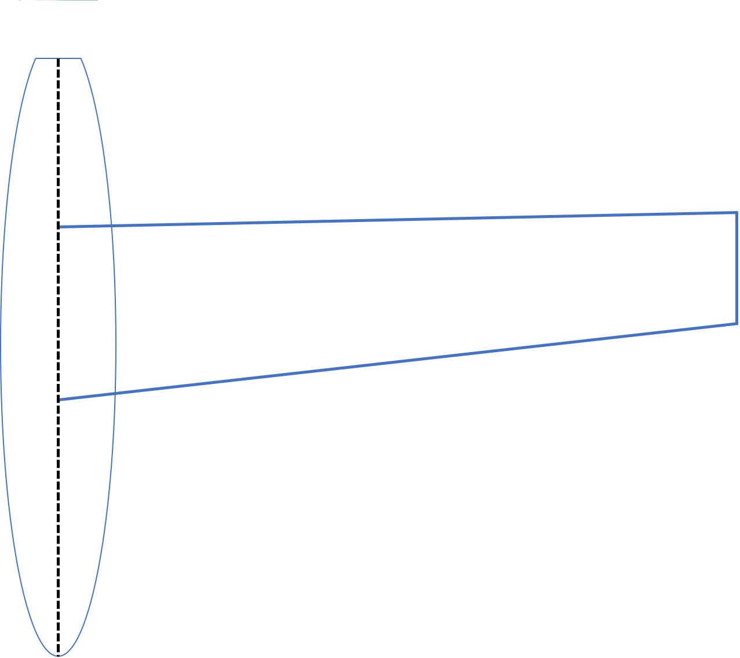






Half-Span, $b/2$
Wing Area, $S=\frac{{(C}_{r}+C_{t}) b}{4}$
Tip Chord, $C_{t}$
Root Chord, $C_{r}$
Wing Sweep, $Λ$
Taper Ratio, $λ=\frac{C_{t}}{C_{r}}$

Slide 2
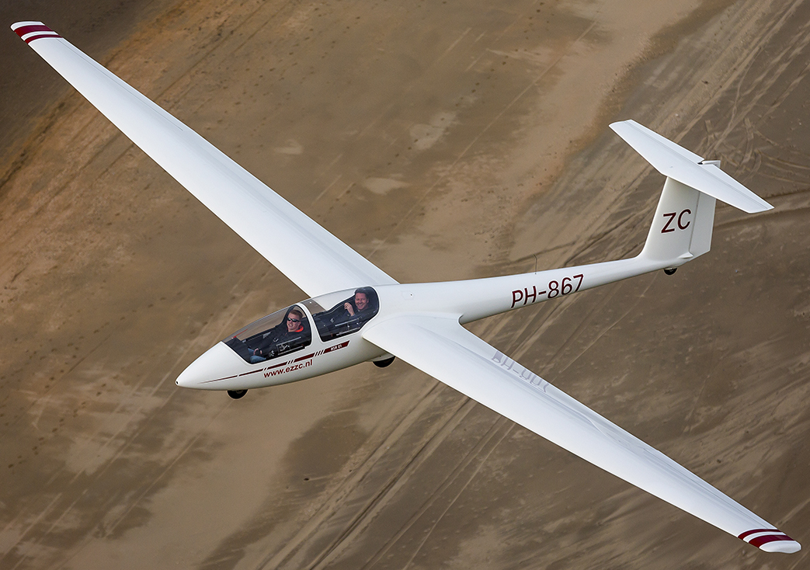
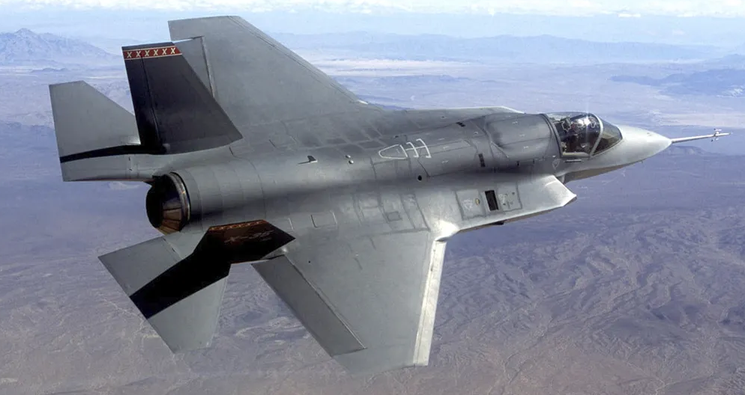
a.
b.

Slide 3
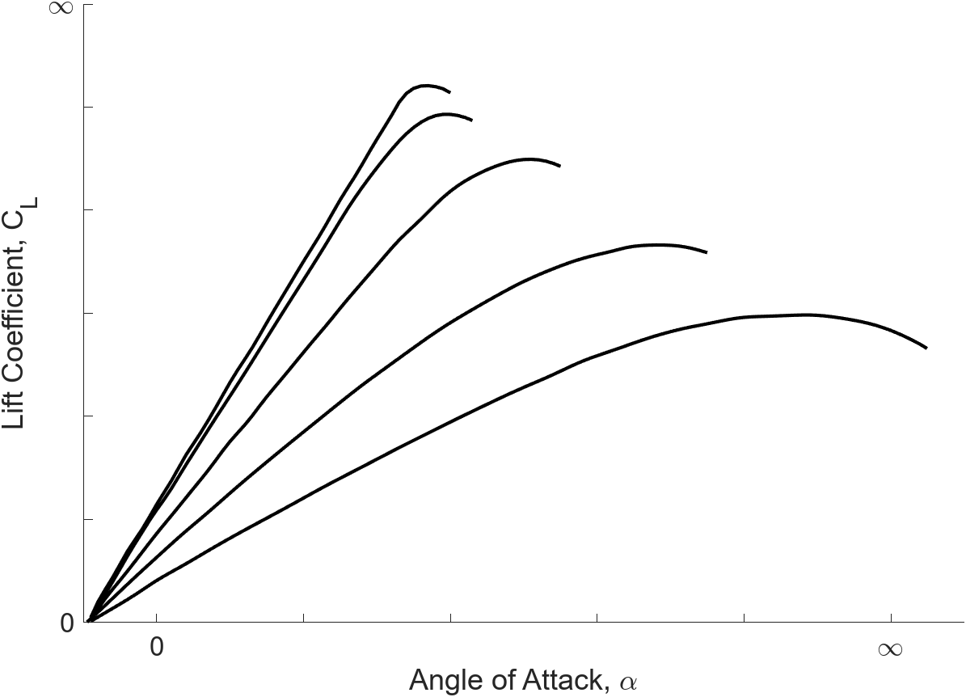





$$AR=∞$$
$$AR=8$$
$$AR=6$$
$$AR=2$$
$$AR=1$$

